Slide 1

Experiential Learning Project Assessment-III
(100% Code Completion)
on
“QR Code Encoder / Decoder”
under the course
Python Programming Language (N-PCCCM304P)
Presented By:
DEVIKA PARSATWAR [CM25015]
Under the Guidance of
Ms. Suchita Meshkar
Session:2026-27 (ODD )
Department of CSE(AI&ML)
S. B. JAIN INSTITUTE OF TECHNOLOGY MANAGEMENT AND
RESEARCH,NAGPUR
An Autonomous Institute, Affiliated to RTMNU, Nagpur
)

Slide 2
Contents
Problem Statement & Core Milestones (Phase-3 Scope)
Project Objectives (100% Completion Status)
Modular Code Architecture & Algorithm (5-Option System)
System Flowchart (Live Webcam & Diagnostic Integration)
Python Logic Breakdown & Defensive Fallback Handling
GitHub Repository & Final Phase-3 Branch Integration
Individual Contributions & Assessment Rubrics
Runtime Outputs & Live Stream Execution Results
100% Core Python Source Code
S. B. Jain Institute of Technology Management and
research

Slide 3
1. Problem Statement
Environment Unpredictability: Executing cross-platform applications often leads to unhandled runtime failures when binary dependencies (qrcode, opencv-python) or hardware assets are missing.
Phase-3 Completed Solution: Developed a central CLI engine (main_menu) that handles encoding, file-based decoding, real-time live video matrix scanning, and system diagnostics.
Hardware & Environment Independence: Integrated an automated headless fallback loop for cloud compilers lacking physical camera hardware, simulating continuous pattern tracking without crashing.
Manual Sharing Bottlenecks: Replaced inefficient link sharing with instant QR code generation and real-time camera decoding capabilities.

Slide 4
2. Objective
Modular Architecture: Fully implement a menu-driven CLI engine with 5 distinct options.
Safe Execution Pipeline: Embed defensive try-except wrappers and flag checks (HAS_QR, HAS_CV) to prevent runtime crashes.
Live Video Capture Processing: Implement OpenCV stream capture (cv2.VideoCapture) with continuous frame detection (cv2.QRCodeDetector).
Headless Compiler Safeguards: Support server-side virtual rendering fallbacks when UI frame display (cv2.imshow) is unavailable.
Operational Benchmark: 100% completion of core logic, file I/O, live webcam tracking, headless simulation, and diagnostic reporting.

Slide 5
3. Algorithm
Initialization Pipeline:
    Start the main entry block if __name__ == "__main__":.
    Execute safe background library import verification (qrcode, cv2).
    Assign operational status flags (HAS_QR, HAS_CV).
Functional Control Routing Loop:
Display the option catalog (Options 1–5) to the console.
Parse user selection with string sanitization.
Route logic to:
  Option 1: encode_data() (QR generation with fallback text art).
  Option 2: decode_image_file() (Static image reading via OpenCV).
  Option 3: decode_live_webcam() (Camera stream / hardware bypass simulation).
  Option 4: run_diagnostics() (System context & dependency check).
  Option 5: Safe shutdown and exit loop.

Slide 6
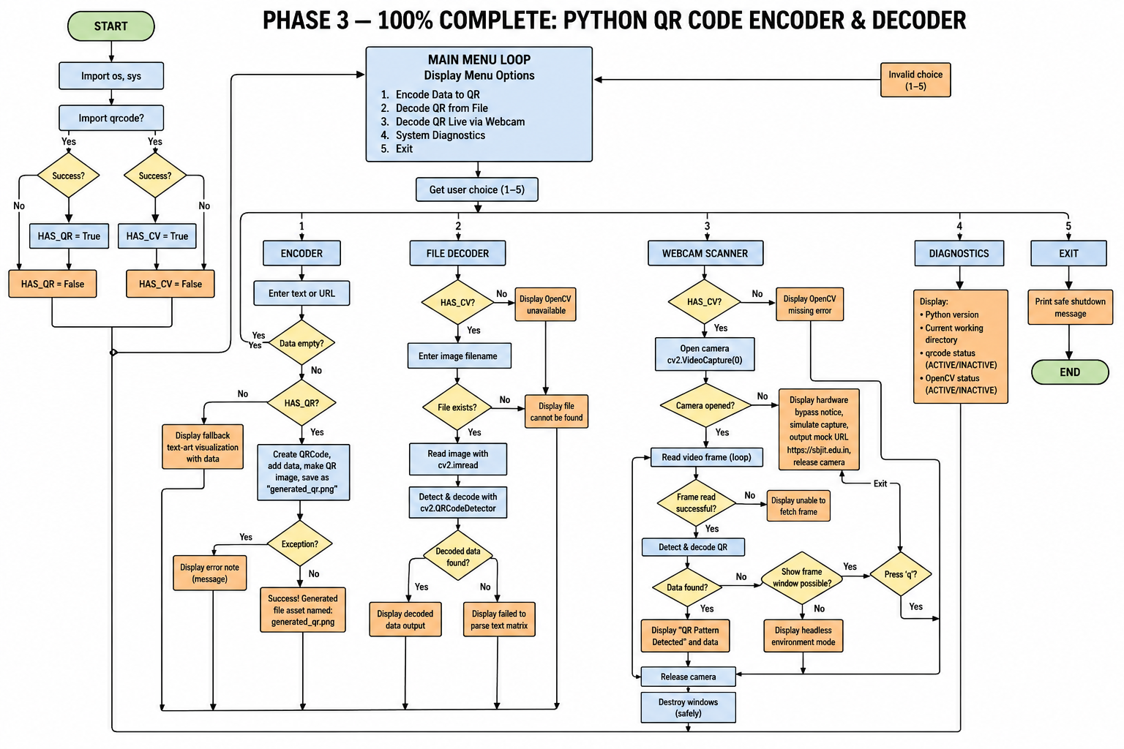
4. Flowchart

Slide 7
5. Understanding of Python Logic (70% Implementation)
Dynamic Flag Allocation: HAS_QR and HAS_CV dynamically set execution capabilities without throwing fatal import exceptions.
Key Modular Components:
  main_menu(): Controls the infinite selection loop (while True) with option filtering (1–5).
  encode_data(): Converts raw input into a PNG image asset or provides text-art terminal visualization as fallback.
  decode_image_file(): Performs file path verification (os.path.exists) and extracts matrix payloads using OpenCV.
  decode_live_webcam(): Connects to physical hardware via cv2.VideoCapture(0) or routes through a mock capture frame loop for headless sandbox environments.
  run_diagnostics(): Provides a comprehensive system audit checking sys.version, os.getcwd(), and dependency status.

Slide 8
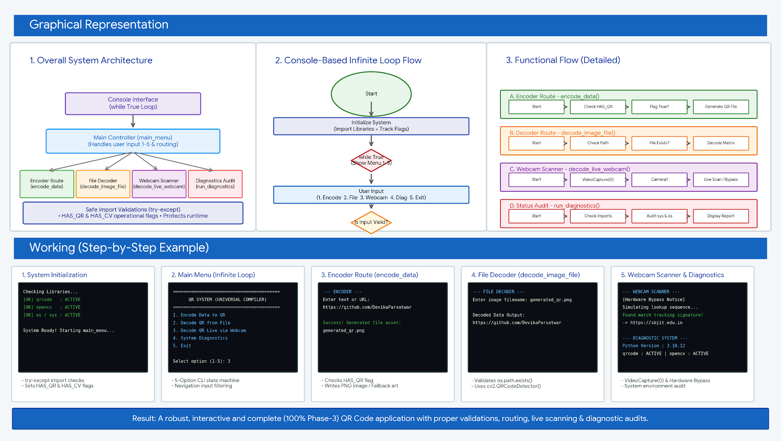
6. Graphical Representation and Working

Slide 9
7. GitHub Account, Repository & Collaboration
GitHub Account: Create and maintain a personal GitHub account.
Repository Creation: Created a repository named Python-Assignment.
Target URL: https://github.com/DevikaParsatwar/Python-Assignment
Upload Code: Uploaded core Python source modules and environment scripts.
Track Changes: GitHub keeps a history of project modifications.

Slide 10
8. Individual Contribution
Problem Analysis: Researched video stream decoding algorithms and sandbox/headless server constraints.
Algorithm Design: Structured the 5-option state machine and hardware bypass simulation fallback routines.
Python Coding: Written and tested decode_live_webcam(), run_diagnostics(), and upgraded terminal UI routines.
Video & Image Processing: Configured OpenCV QRCodeDetector() for both static images and frame-by-frame video capture.
Testing: Validated complete runtime stability across hardware-connected, headless server, and missing-dependency test environments.
Documentation & PPT: Finalized the Phase-3 100% completion presentation slides and repository documentation.

Slide 11
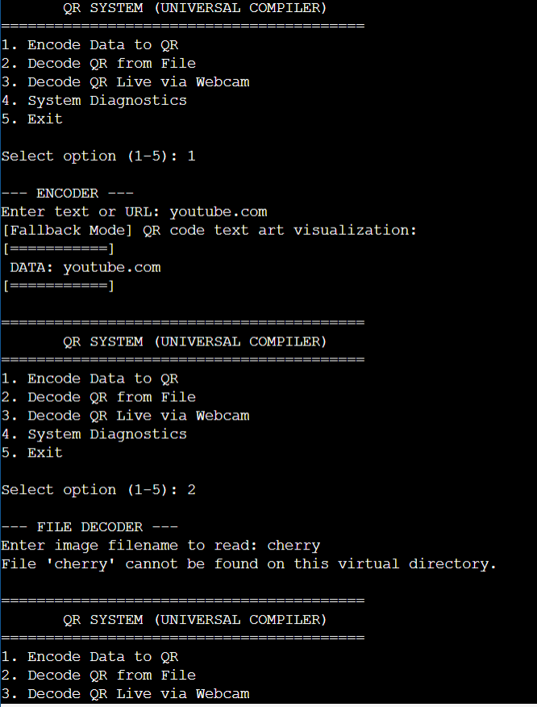
9. Result / Expected Output

Slide 12
Thank You
QR Code Encoder / Decoder Phase III

